Slide 1
Types of Graphs

Slide 2
Line graphs

Slide 3
Line graphs
Line graphs makes the comparison of various sets of data.
the plotted peaks and dips on the grid monitors and compares improvement and decline.

Slide 4
Line Graphs
Scientists use line graphs all the time, as do all types of professionals and students

Slide 5
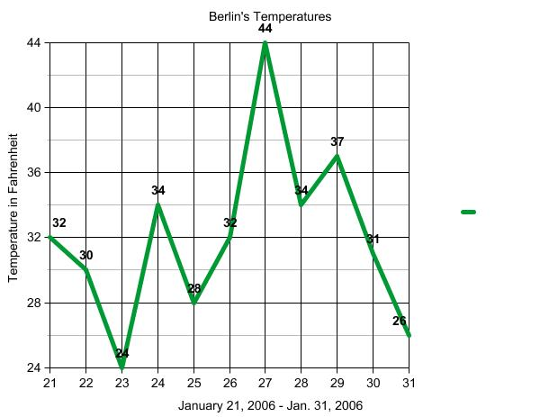
Sample of line graphs

Slide 6
