Slide 1
ASSESSMENT: FORMATIVE & SUMMATIVE
Practices for the Classroom

Slide 2
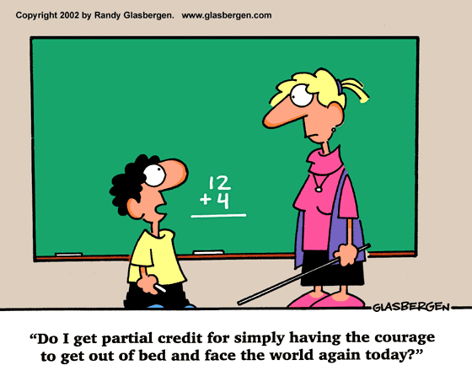

Slide 3
Keys to Sound Assessment
What:
Is the target clear
and appropriate?
Why:
Is the purpose for
Assessment clear?
How:
What assessment method
will work best?
How much:
How can we sample
appropriately?
How accurate:
bias and distortion

Slide 4
Types of Achievement Targets
Teachers must be able to clearly articulate appropriate achievement targets.
• Knowledge & understanding
• Reasoning proficiency
• Performance skills
• Ability to create products
• Dispositions

Slide 5
Knowledge Mastery
The mastery of substantive subject matter knowledge where mastery includes both knowing and understanding. Mastery is defined as both knowing information outright and through the effective use of appropriate reference materials. Includes both declarative and procedural knowledge.

Slide 6
Reasoning
The ability to use knowledge and understanding to reason, where reasoning leads to the ability to solve problems.

Slide 7
Skills
The development of certain skills, where it is the process of doing something that is important, such as reading aloud, speaking in a second language, or using psychomotor skills.

Slide 8
Products
The ability to use skills to create certain kinds of tangible products, such as samples of writing, reports, and art products, which exist independently of the performer but which provide concrete evidence of proficiency.

Slide 9
Dispositions
Affective and personal feeling states, such as attitudes, sense of academic self-confidence, or interest in something that motivationally predisposes a person to act or not act.
It is directed at some specific object
It has a positive or negative direction
It can vary in level of intensity, from strong to weak

Slide 10
Keys to Sound Assessment
What:
Is the target clear
and appropriate?
Why:
Is the purpose for
Assessment clear?
How:
What assessment method
will work best?
How much:
How can we sample
appropriately?
How accurate:
bias and distortion

Slide 11
Assessment Methods
Selected response - select a correct or best response
multiple choice
true/false
matching
Production - produce a response
completion/short answer
essay, both restricted and extended response
performance assessmemt

Slide 12
Assessment Methods Continued
Personal communication - a direct communication, either orally or in writing
interviews/conferences
question-answer sessions/discussions
think-alouds

Slide 13
Performance-Based Assessments
Tasks that ask students to perform, create, produce, or do something. These assessments may tap process, product, or both. Student performances can be evaluated with checklists, rating scales, or rubrics.

Slide 15
What is Assessment?
The word ‘assess’ comes from the Latin verb ‘assidere’ meaning ‘to sit with’.
In assessment one is supposed to sit with the learner. This implies it is something we do ‘with’ and ‘for’ students and not ‘to’ students (Green, 1999).

Slide 16
Assessment in education is the process of gathering, interpreting, recording, and using information about pupils’ responses to an educational task. (Harlen, Gipps, Broadfoot, Nuttal,1992)

Slide 17
The State of Assessment
“A wealth of research – a poverty of practice.” (Black and Wiliam, 1998)
Shift from “teaching” to “learning”
Preservice and inservice training
Confusion of terms and conditions
Evaluation
Assessment
Formative
Summative

Slide 18
Formative and summative assessment are interconnected. They seldom stand alone in construction or effect.
The vast majority of genuine formative assessment is informal, with interactive and timely feedback and response.
It is widely and empirically argued that formative assessment has the greatest impact on learning and achievement.

Slide 19
Values and Attitudes about Assessment
Teachers value and believe in students.
Sharing learning goals with the students.
Involving students in self-assessment.
Providing feedback that helps students recognize their next steps and how to take them.
Being confident that every student can improve.
Providing students with examples of what we expect from them.

Slide 20
Formative Assessment
Assessment for learning
Taken at varying intervals throughout a course to provide information and feedback that will help improve
the quality of student learning
the quality of the course itself

Slide 21
“…learner-centered, teacher-directed, mutually beneficial, formative, context-specific, ongoing, and firmly rooted in good practice" (Angelo and Cross, 1993).
Provides information on what an individual student needs
To practice
To have re-taught
To learn next

Slide 22
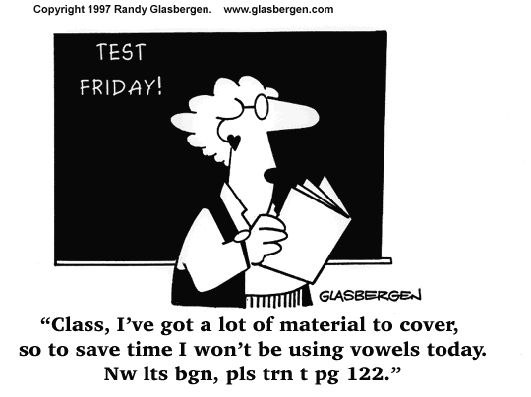

Slide 23
Key Elements of Formative Assessment
The identification by teachers & learners of learning goals, intentions or outcomes and criteria for achieving these.
Rich conversations between teachers & students that continually build and go deeper.
The provision of effective, timely feedback to enable students to advance their learning.
The active involvement of students in their own learning.
Teachers responding to identified learning needs and strengths by modifying their teaching approach(es).
Black & Wiliam, 1998

Slide 24
Summative Assessment
Assessment of learning
Generally taken by students at the end of a unit or semester to demonstrate the "sum" of what they have or have not learned.
Summative assessment methods are the most traditional way of evaluating student work.
"Good summative assessments--tests and other graded evaluations--must be demonstrably reliable, valid, and free of bias" (Angelo and Cross, 1993).

Slide 25
Formative
‘… often means no more than that the assessment is carried out frequently and is planned at the same time as teaching.’ (Black and Wiliam, 1999)
‘… provides feedback which leads to students recognizing the (learning) gap and closing it … it is forward looking …’ (Harlen, 1998)
‘ … includes both feedback and self-monitoring.’ (Sadler, 1989)
‘… is used essentially to feed back into the teaching and learning process.’ (Tunstall and Gipps, 1996)
Summative
‘…assessment (that) has increasingly been used to sum up learning…’(Black and Wiliam, 1999)
‘… looks at past achievements … adds procedures or tests to existing work ... involves only marking and feedback grades to student … is separated from teaching … is carried out at intervals when achievement has to be summarized and reported.’ (Harlen, 1998)

Slide 26
The Garden Analogy
If we think of our children as plants …
Summative assessment of the plants is the process of simply measuring them. It might be interesting to compare and analyze measurements but, in themselves, these do not affect the growth of the plants.
Formative assessment, on the other hand, is the equivalent of feeding and watering the plants appropriate to their needs - directly affecting their growth.

Slide 27
Factors Inhibiting Assessment
A tendency for teachers to assess quantity and presentation of work rather than quality of learning.
Greater attention given to marking and grading, much of it tending to lower self esteem of students, rather than providing advice for improvement.
A strong emphasis on comparing students with each other, which demoralizes the less successful learners.

Slide 28
Self-evaluation
Where would you place your assessment practice on the
following continuum?
The main focus is on:
Quantity of work/Presentation
Quality of learning
Marking/Grading
Advice for improvement
Comparing students
Identifying individual
progress

Slide 29
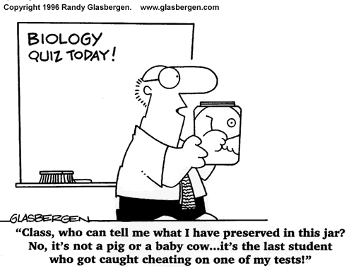

Slide 30
Forms of Summative Assessment
Performance Assessment
Portfolio, Reflective Journal etc.
Traditional Tests

Slide 31
Implications for classroom practice
Share learning goals with students.
Involve students in self-assessment.
Provide feedback that helps students recognize their next steps and how to take them.
Be confident that every student can improve.

Slide 32
K-6 Student Assessment
2005-2006
Grade | Assessment | Type of |  | Timeframe | Other
Level(s) | Tool | Assessment
Kindergarten | *Observational Survey | Summative |  | End of Kindergarten Year | Results given to principals
K- 4 | *Guided Reading Levels | Formative |  | Dec./Jan, March, May/June | Results given to principals
K- 6 | *Writing Sample | Summative |  | April - June | *
 | *Pre Tests | Formative |  | Throughout Year | *
 | *Post Tests | Summative |  | Throughout Year | *
 | *District Wide Math Assessment | To be determined |  | To be determined | To be determined
1st - 6th | *Benchmarks | Formative |  | Throughout Year | Administered to new and/or low achieving students
 | *Writing Prompt | Summative |  | January - March (TBD) | *

Slide 33
K-6 Student Assessment
2005-2006
Grade | Assessment | Type of |  | Timeframe | Other
Level(s) | Tool | Assessment
2nd - 6th | *Qualitative Spelling Inventory | Formative |  | Completed by Nov. 1st | To be shared at parent conference
 | *M.A.P. (NWEA) | Formative |  | September | *
 | *M.A.P. (NWEA) | Summative |  | June | *
 |  |  |  | Full implementation by June, 2006 | Will replace QRI, Benchmarks, Gates and possibly Terra Nova
3rd - 6th | *NECAP | Summative |  | October | *
5th - 6th | *Record of Instructional Reading Progress | Summative |  | Dec./Jan, March, May/June | Results given to principals

Slide 34
